Slide 1
CARRO

Slide 2
Problem
So many people are facing parking issues in metropolitan cities like Banglore , Delhi , Hyderabad , Mumbai ,Chennai.
They are facing parking issues in Shopping Malls , Restaruants , Theaters ,Hospitals.
People are waiting for so much time for car parking.
Approximately 90 million people are facing this problem.

Slide 3
solution
We came with an app named ” CARRO”.
Here in this app we can book our parking slot in respective places from any where .
It helps to reduce the waiting time
We can book slot atleast 1 hour before.

Slide 4
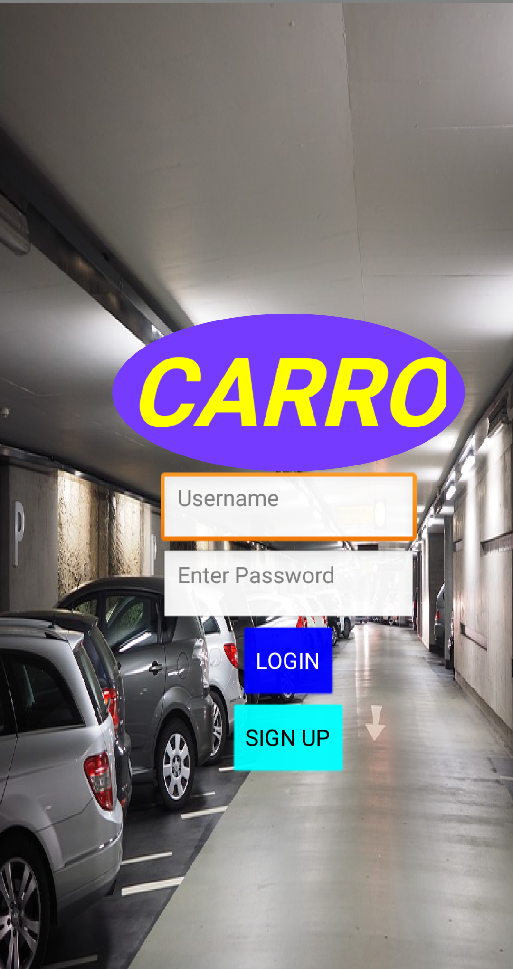
Here we can login in this app

Slide 5
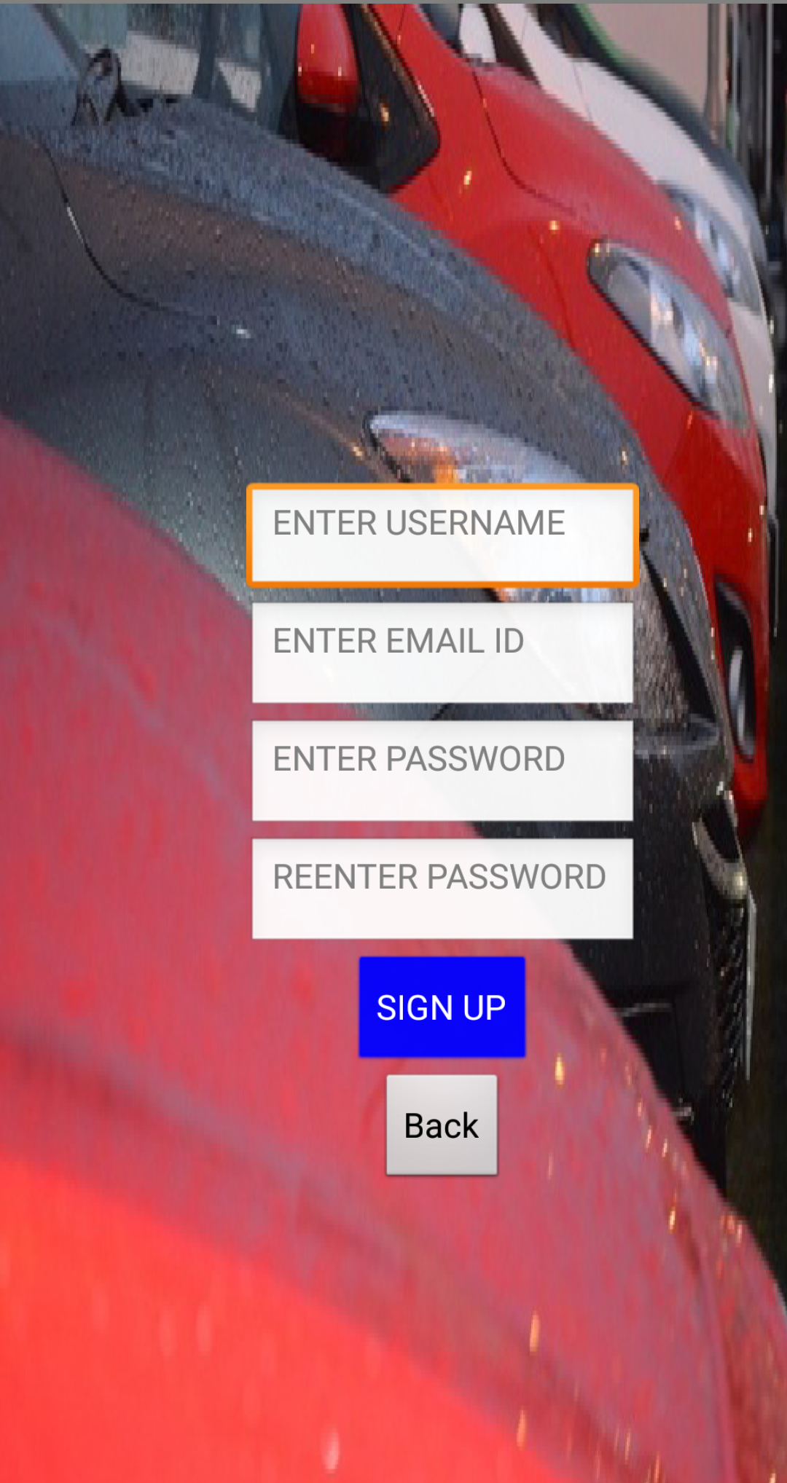
new users have to register here

Slide 6
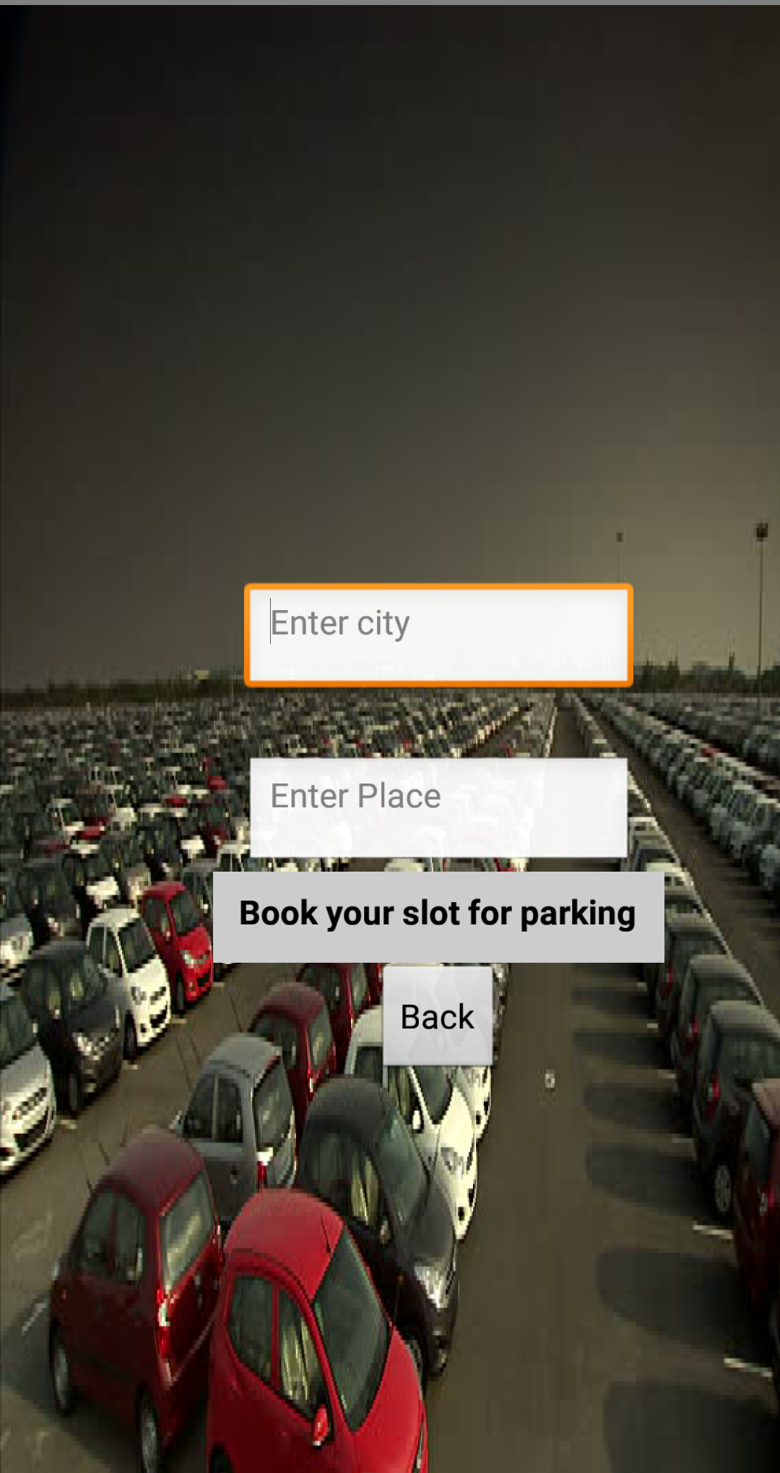
Here we have to enter our city name and the place

Slide 7
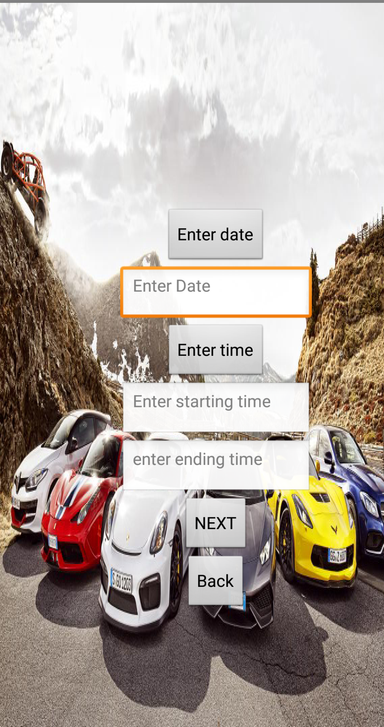
We have to enter our date and starting time and the ending time

Slide 8
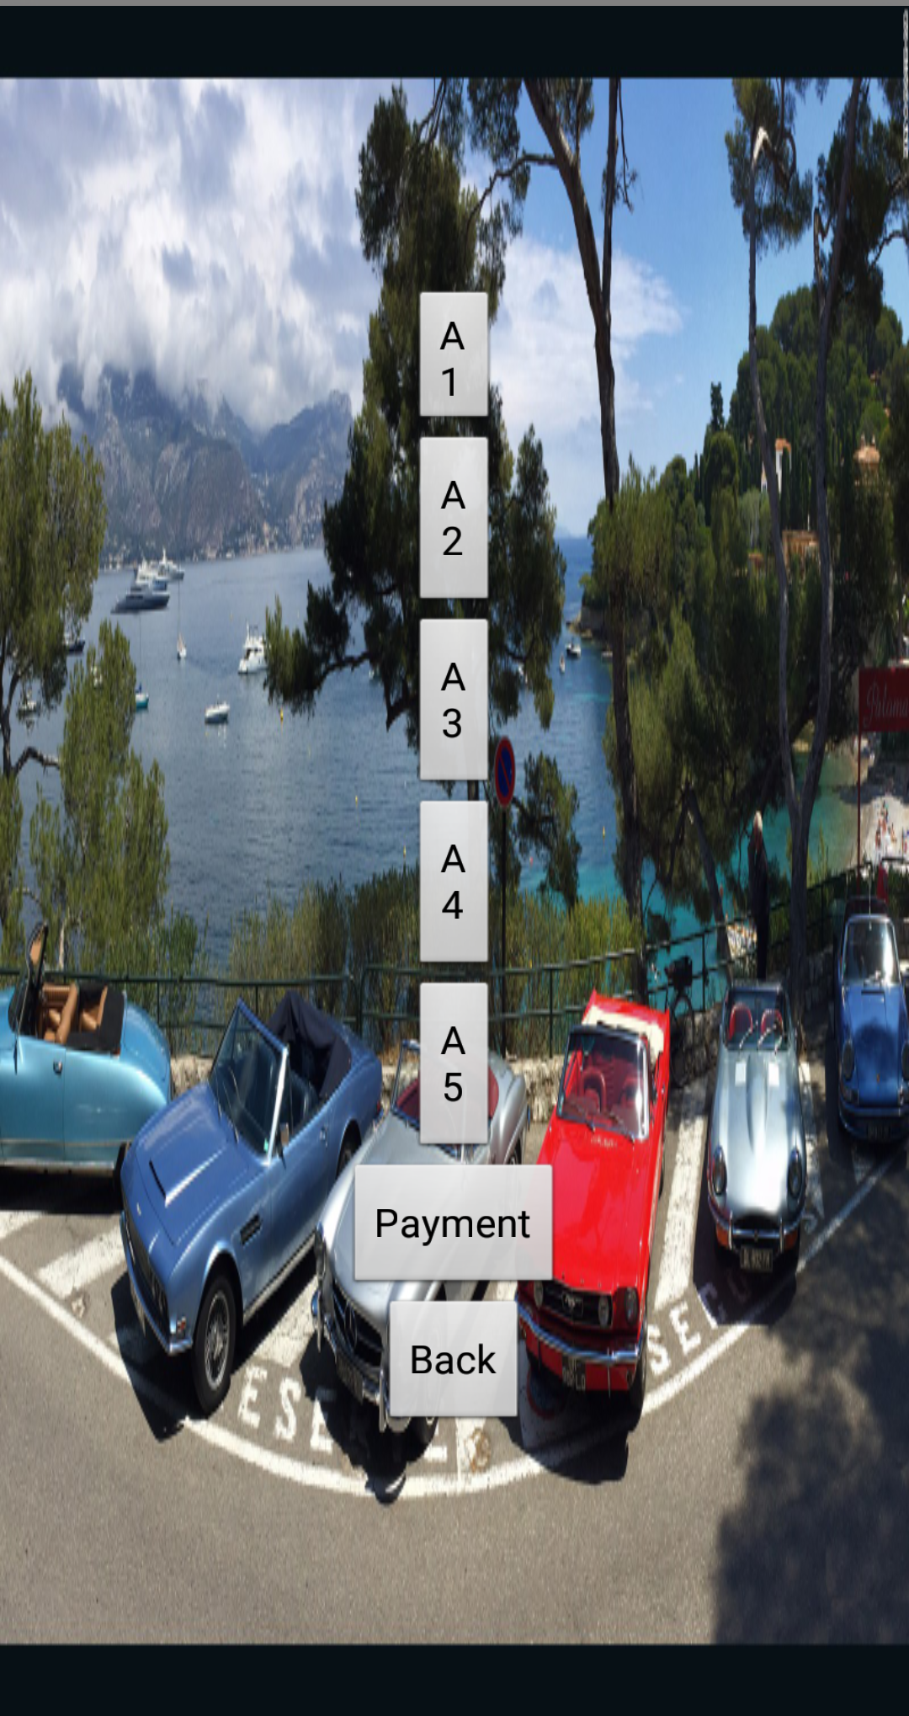
Here we can book the available slot

Slide 9
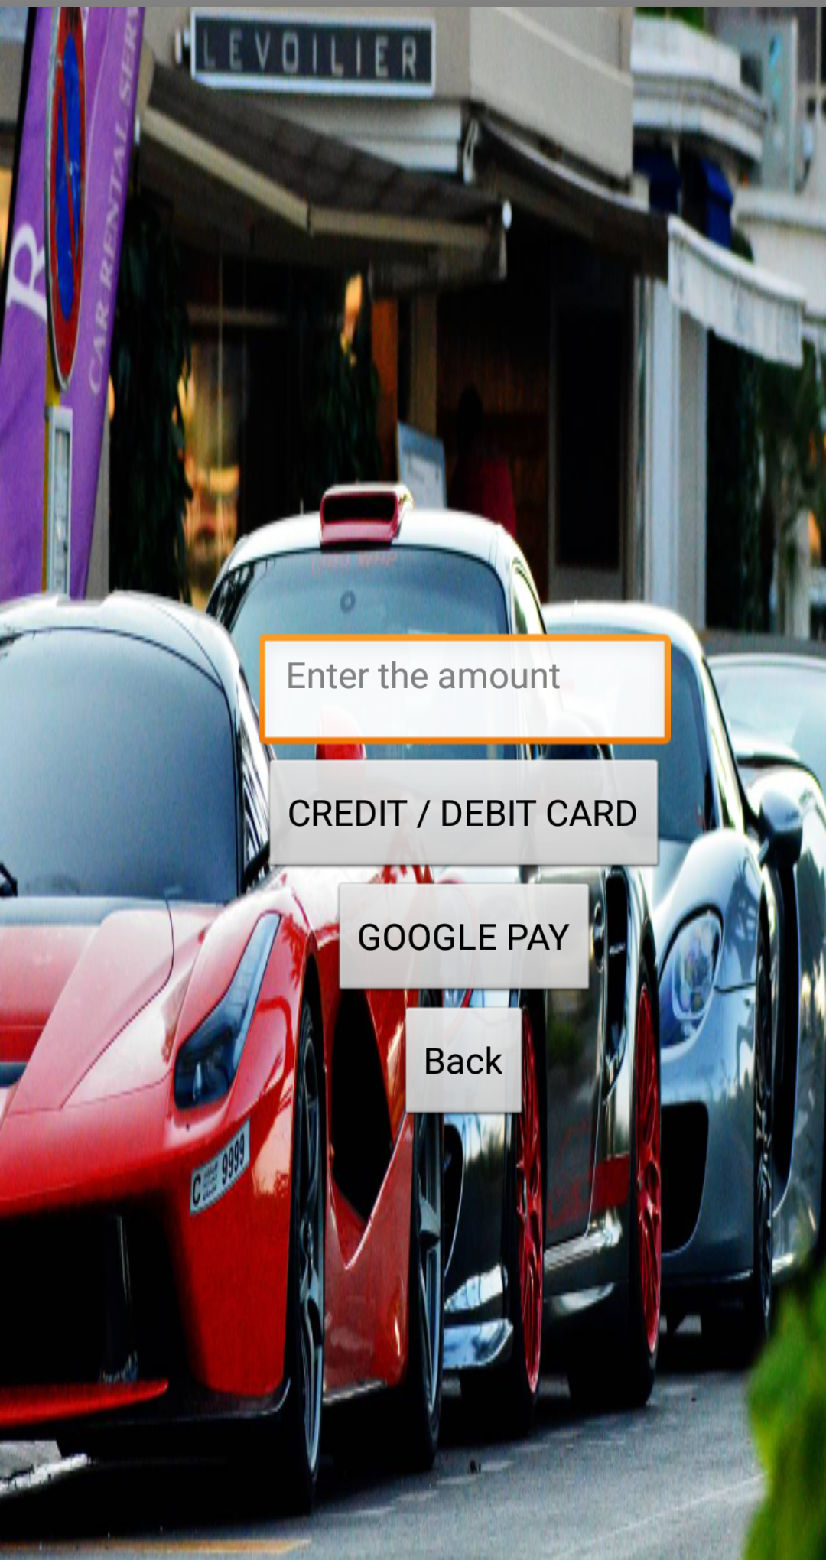
Here we have the mode of payment through credit/debit card.or google pay.

Slide 10
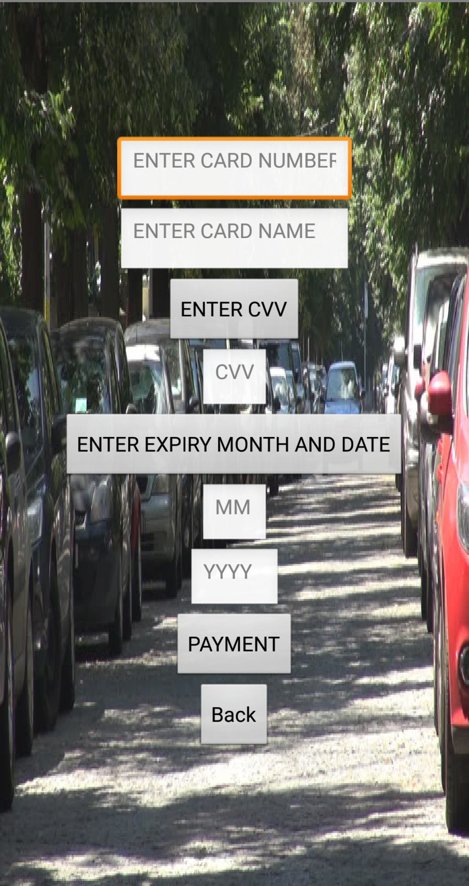
We should enter our card details.

Slide 11
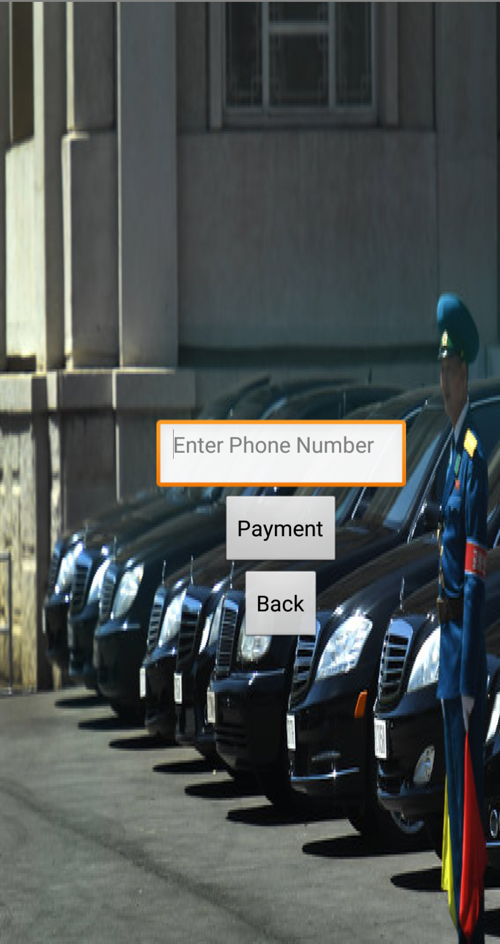
For google pay.

Slide 12
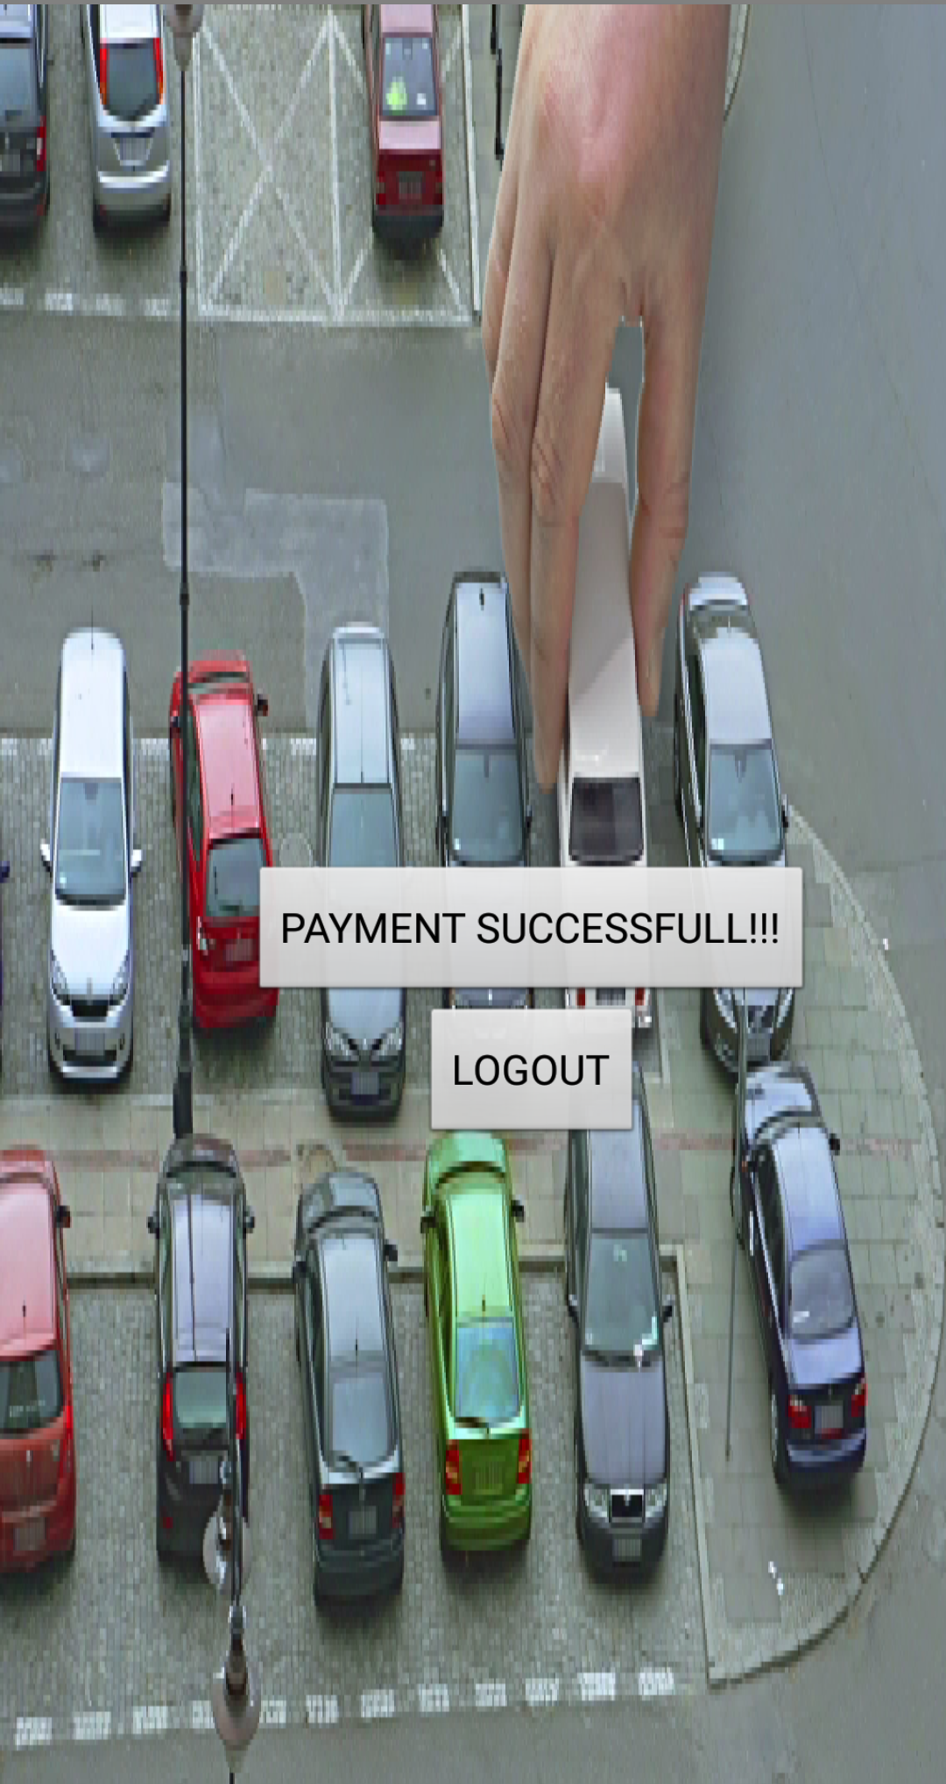
Transaction completed, Now we can park our car.

Slide 13
THANK YOU done by: 1. Vamsi Gupta 2. Jatin Manikanta 3. Pavan Kumar 4. Janardhan

